Slide 1

JAVA PROGRAMMING
CLASS 2015 – 2016
CSE dept.
Minia Uni.
Faculty of Engineering

Slide 2
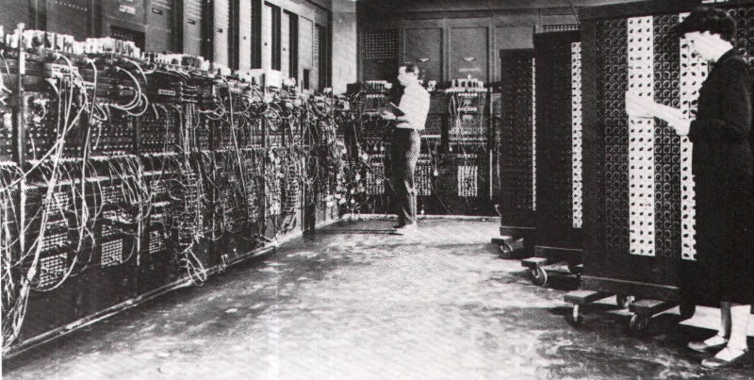
History
http://cs.brown.edu/~adf/programming_languages.html (good article)
Von Neumann (0s and 1s)
Assembly [low level]
Fortran: FORmula TRANslating system (first computer language)
C/C++ …etc [high level]
ENIAC, world’s first digital computer

Slide 3

What is JAVA
It's name come from Java Coffee which is a coffee bean produced in the Java islands of Indonesia.
Java programming language was originally developed by Sun Microsystems which was initiated by James Gosling and released in 1995 as core component of Sun Microsystems' Java platform (Java 1.0 [J2SE]).
The latest release of the Java 2 (J2) Standard Edition is Java SE 8.
J2SE Standard Edition
J2EE for Enterprise Applications
J2ME for Mobile Applications

Slide 4
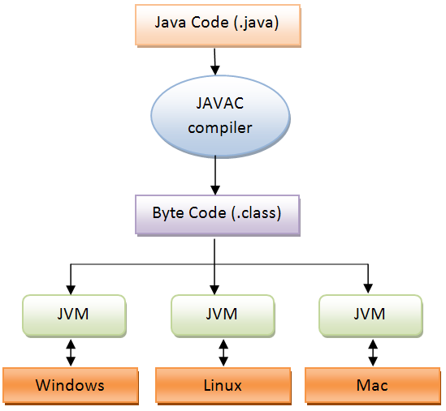
JAVA [Write once, Run Anywhere]
High Level Language
Platform Independent
Portable
Object Oriented
Notes:
The original meaning of 'portable' was 'costs less to convert to a new platform than it does to rewrite for the new platform'. As languages evolved and vendor lock-ins reduced, it has since morphed to mean several things including binary compatibility and source-code compatibility.
'Platform-independent' means that there is nothing in the system or its specification that is inherently bound to a single platform

Slide 5
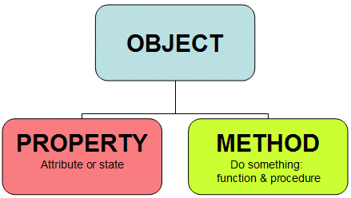
Object Oriented Programming (OOP)
OOP is a software design philosophy.
A class is simply a representation of a type of object. It is the blueprint, or plan, or template, that describes the details of an object. A class is the blueprint from which the individual objects are created. Class is composed of three things: a name, attributes, and operations.
CLASS

Slide 6
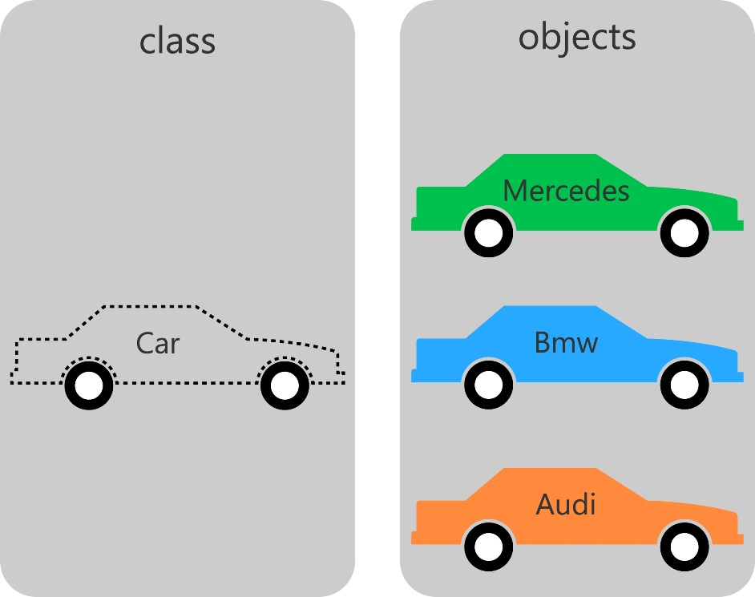
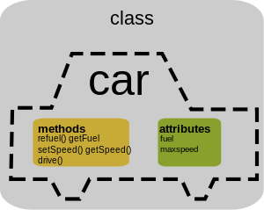
Example

Slide 7
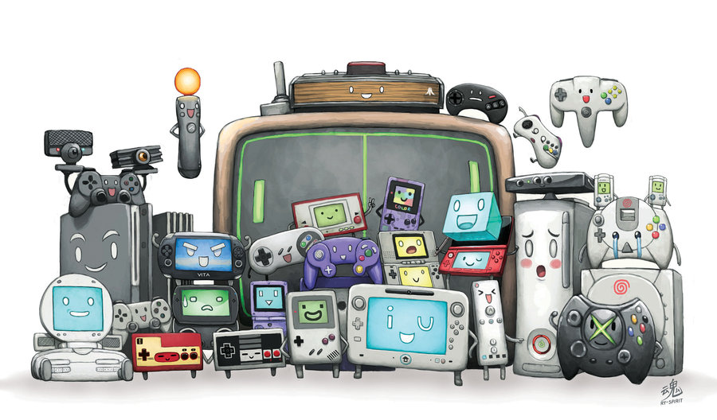
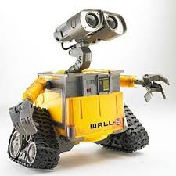
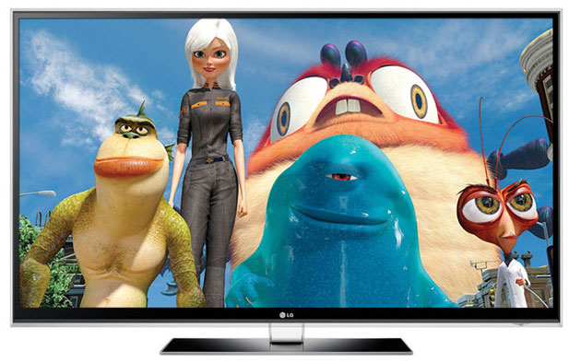


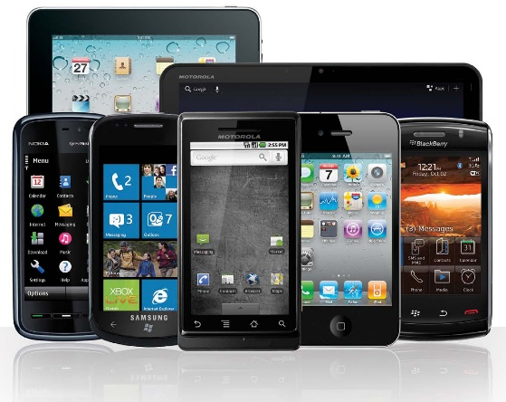
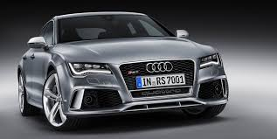
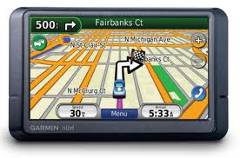
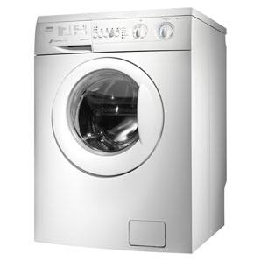

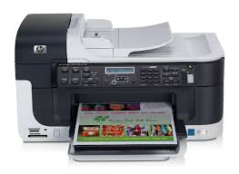
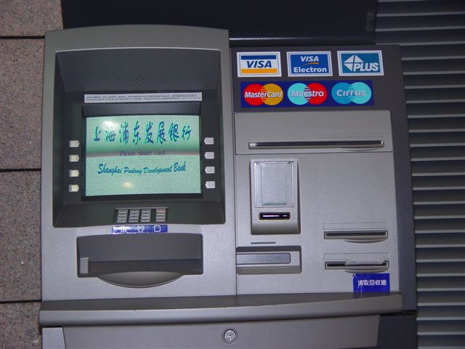
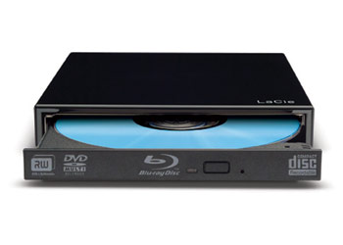
3 Billion devices use java

Slide 8
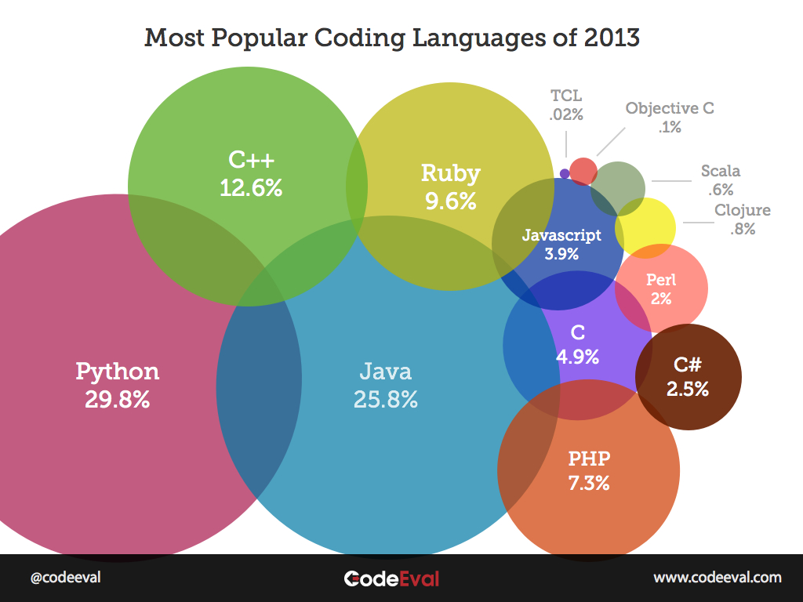

Slide 9

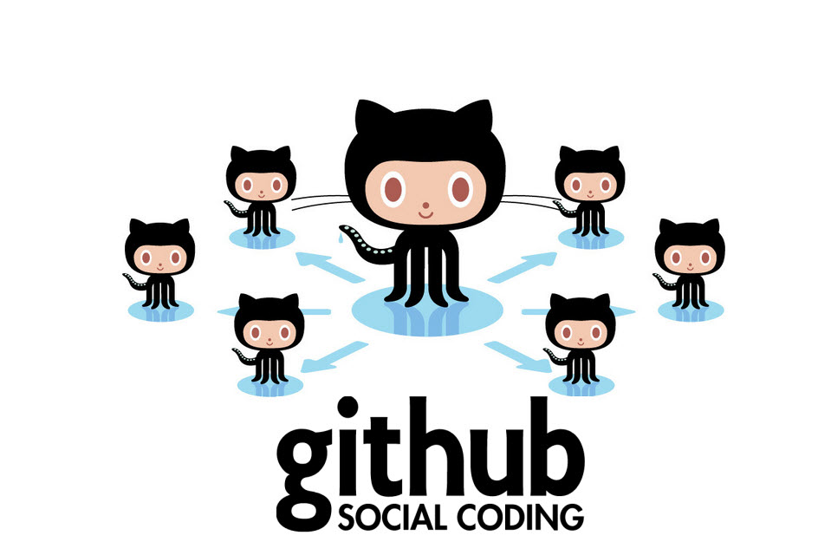
Tools
Java Development Kit JDK 8
Text editor or IDE:
NetBeans IDE
Eclipse IDE
MS Notepad text editor
GitHub source control

Slide 10
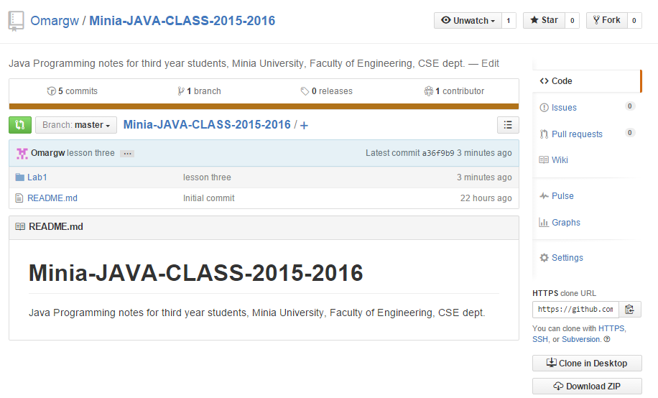
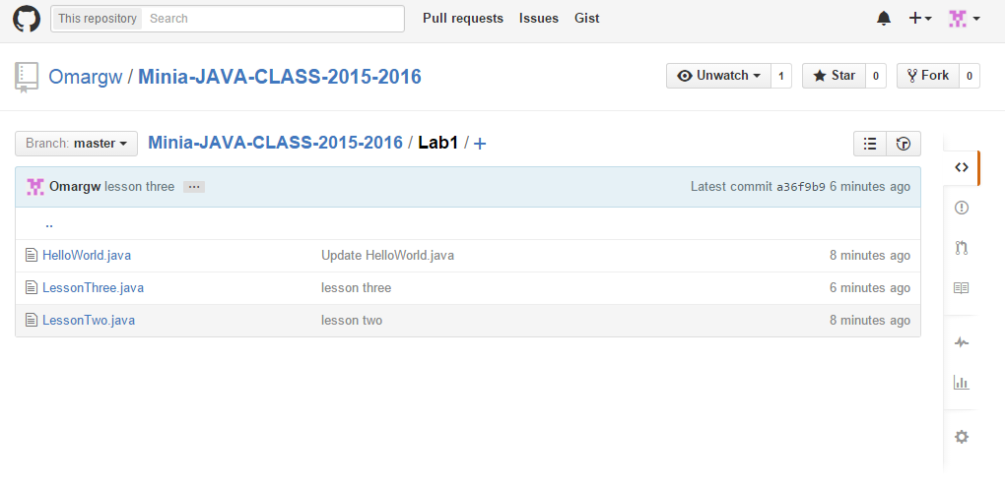
Repository Page

Slide 11
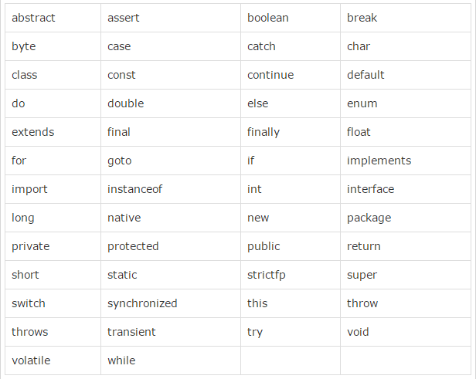
Java Keywords

